Slide 1
HOSPITAL COMMITTEES
Role,
Composition,
Frequency of Meetings,
Minutes Of The Meetings,
Follow Up Actions

Slide 2
Role
To ensure safe high quality patient care.
To prepare annual budget.
To ensure the hospital provides care treatment and services in accordance with laws, rules and regulation and Licenses.
To ensure adequate space and equipment are available for patient care .

Slide 3
Types of Committees Required
Quality and safety committee
Infection committee
Pharmacy and therapeutics committee
Blood transfusion committee
Medical records committee
Beyond these 5 committees to be handled by Quality and Safety Committees

Slide 4
Criteria For Forming A Committee
Scope of committee should be defined properly
Members of committee according to the nature of committee
Frequency of meeting should be defined
Emergency meeting can be called by chairperson
House rules to be set

Slide 5
Frequency of Meetings
Meeting cadence refers to the frequency of team meeting or how often recurring meeting are held.
Some common meeting cadences are daily, weekly, bi-weekly, monthly, and bi-monthly, and quarterly.

Slide 6
During Meeting
Each agenda should be discus appropriately
Each and every member should be given opportunity to give his opinion
Responsibility given to concern person with defined time frame for each task
Minutes of meeting should be documented
Attendance list should be signed by each participant

Slide 7
Minutes of the meeting
Meeting minutes also called meeting notes, are the written record of everything that happened during a meeting . They are not the same as the meeting agenda which is prepared in advance and refers to the list of activities that participants are hoping to accomplish during their meeting.

Slide 8
A Meeting Minutes Summarize The Key Issues Discussed . Minutes Will Generally Be In Bullet Point From And Will Note Any Decisions Made Or Conclusions Stated During The Meeting.
Different types of minutes
Action minutes
Discussion minutes
Verbatim minutes

Slide 9
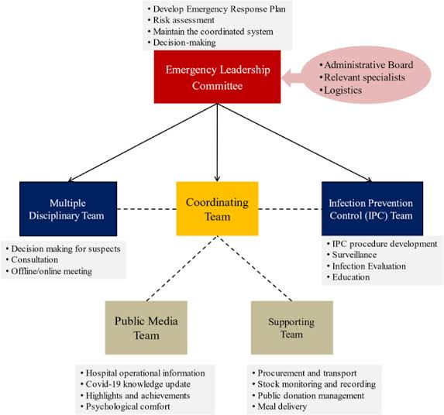
The organizational structure

Slide 10
Follow Up Actions
An action or thing that serves to increase the effectiveness of previous one . When applied to investing and trading , this means adding or changing a position or strategy to revise it risk profile or expected returns

Slide 11
Conclusion
Committees monitor on-going operations identify issues suitable for legislative review gather and evaluate information and recommend courses of action to the senate.

Slide 12
Thank you

